Slide 1
Module 9: Build business process flows

Slide 2
Business process flows
Why use business process flows
Using the business process flow designer
Automating with your business process flow

Slide 3
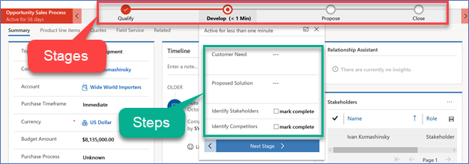
What is a business process flow?
A guide, roadmap,
recipe, …
Stages and steps
Stage gating
Conditional branching
Include multiple tables
Switch at any time
Role tailored
Automation and Developer APIs

Slide 4
Differences between a business process flow and a regular flow in Power Automate
A business process flow is a visual guide meant to help users complete a business process by using a set of predefined stages.
A Power Automate flow does not have any visual components like a business process flow.

Slide 5
Business process flows value to organizations
Business process flows allow organizations to quickly standardize how processes are completed and what data is collected at each stage.
Improved outcomes
Consistent stages and work steps across all instances of the process
Improved data collection and reporting
Decreased time to complete the process
Predictable outcomes

Slide 6
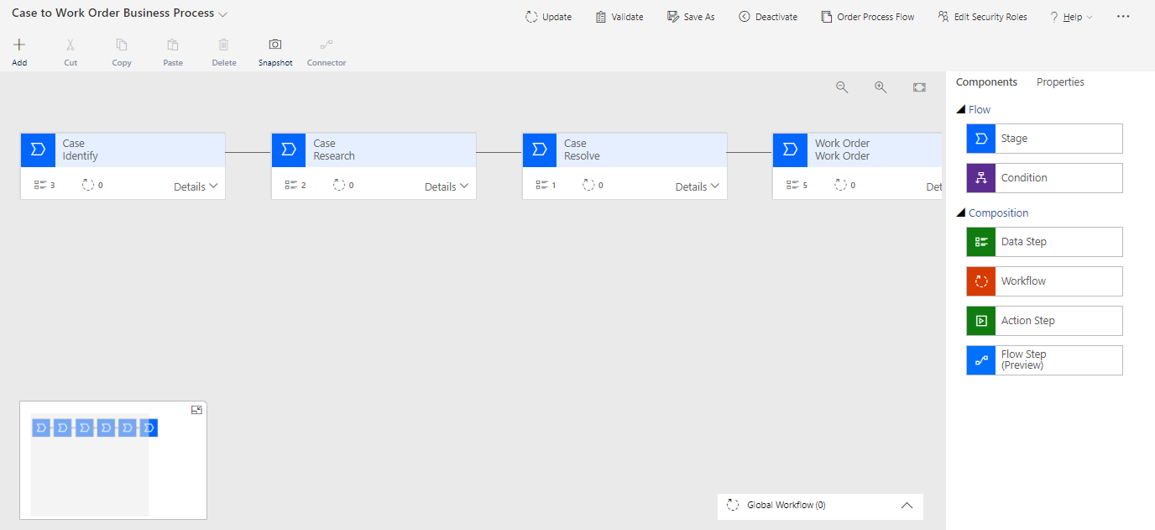
Process Designer
Notes:
Start Time xx:xx / Length: 2 minutes
Review the learning objectives.

Slide 7
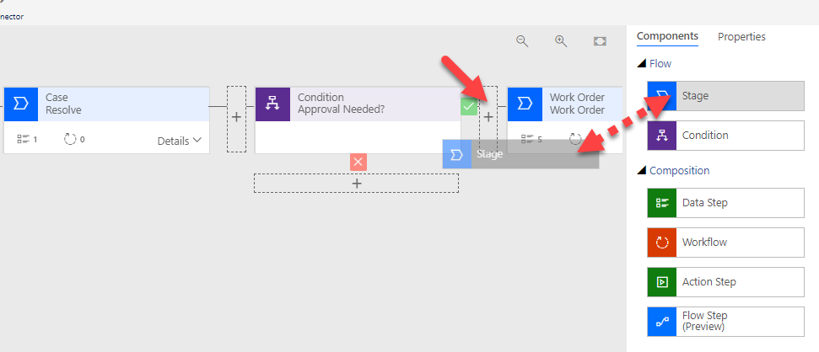
Drag and Drop Positioning
Notes:
Start Time xx:xx / Length: 2 minutes
Review the learning objectives.

Slide 8
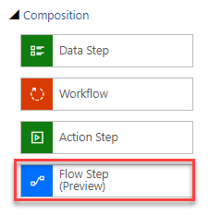
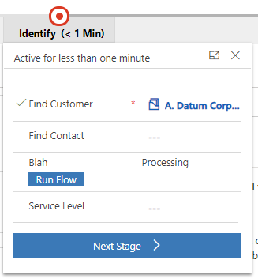
Adding a cloud flow step
Add flow button as step in stage.
Flow must be created before adding to BPF.
Only solution aware flows can be added as a steps.
Gating can be added to flow step to prevent advancing stages before the flow has been run.
Request Approval
Notes:
Start Time xx:xx / Length: 2 minutes
Review the learning objectives.

Slide 9
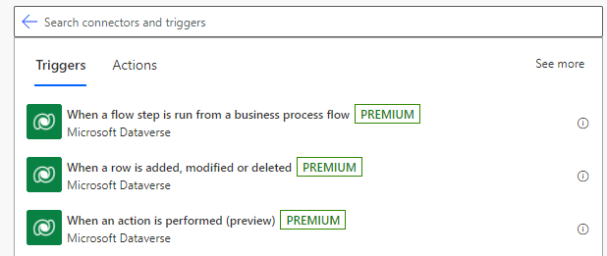
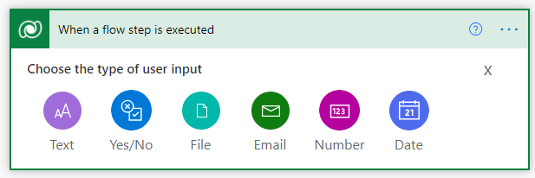
Creating a cloud flow that will be used as a step
Make sure to create flow from inside a solution.
Available flows can be:
Instant flows: Any flow that is defined as an instant flow
When a flow step is executed: New trigger available with the Microsoft Dataverse connector
Input parameters can be passed to the flow to assist in processing.
Input parameters cannot be pulled from the calling record.
Notes:
Start Time xx:xx / Length: 2 minutes
Review the learning objectives.

Slide 10
Triggering Power Automate flows
Trigger flow on events from the process table
Create (Process Applied)
Update (Status/State Change)
Delete
Perform actions or check conditions
Apply a process
Check / Modify Active Stage
Check / Modify Current Status
Notes:
Start Time xx:xx / Length: 2 minutes
Review the learning objectives.

Slide 11
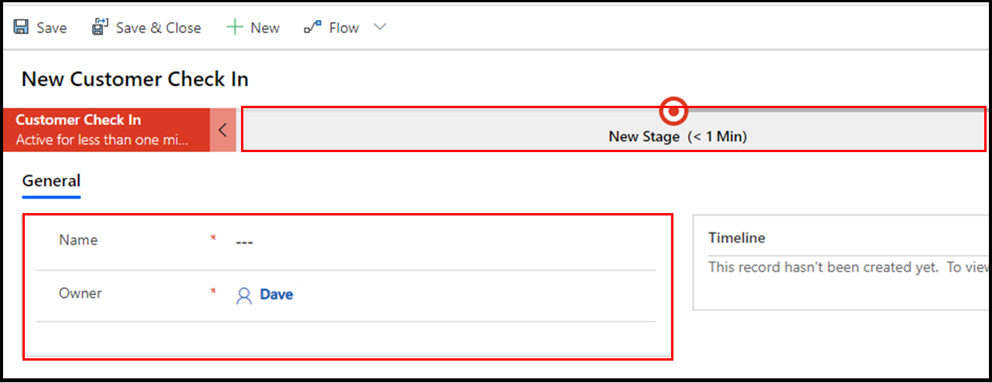
Enhance the form to augment a business process flow

Slide 12
Closing slide
Business process flow or cloud flow?

Slide 13
Want a simple visual guide to help users complete a process.

Slide 14
Want to trigger a flow based on data outside of Dataverse (SharePoint, for example).

Slide 15
Module 9 practice labs
Lab 9.1: Build a business process flow
Lab 9.2: Build a branching business process flow

Slide 16
Summary
Business process flows offer users an on-screen guide to follow to complete their tasks
Business process flows can be specialized for each table and roles
Business process flows seamlessly integrate with available Power Platform automation

Slide 17
close

